Slide 1

Facial Emotion Recognition and Analysis
Team 35
Sonal Dangi
Shikhar Mahajan
Jahanvi Sisodiya

Slide 2
Introduction
Emotion recognition is the process of identifying human emotion, most typically from facial expression as well as from verbal expressions. This is both something that humans do automatically but computational methodologies have also been developed.

Slide 3
Why Emotion Recognition?
The study of Mehrabian stated that to understand emotion or intention of a person, 55% of the information are conveyed through facial expressions alone, 38% through vocal cues, and the remaining 7% via verbal cues. This encourages the researchers to explore deeply in the area of facial expressions recognition and analysis (FERA). Ekman et al. asserted after extensive study.

Slide 4
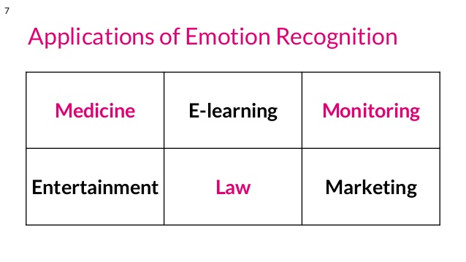
Applications of Emotion Recognition

Slide 5
DataSet Used
COHN-KANADE -- CK+
Facial emotions has been classified into 8 classes :
1. Neutral 6. Surprise
2. Happiness 7. Contempt
3. Sad 8. Angry
4. Fear
5. Disgust

Slide 6
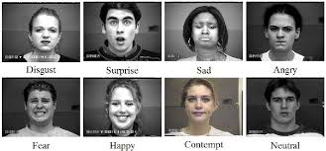

Slide 7
FER2013
Emotions classified into 7 classes
1.Happy
2.Angry
3.Disgust
4.Fear
5.Sad
6.Surprise
7. Neutral

Slide 8
Libraries Used
Open CV
Glob
Keras
Sklearn
Imbalanced Learn

Slide 9
CNN model
Convolutional Neural Network (ConvNet/CNN) can take in an input image, assign importance (learnable weights and biases) to various aspects/objects in the image and be able to differentiate one from the other.

Slide 10
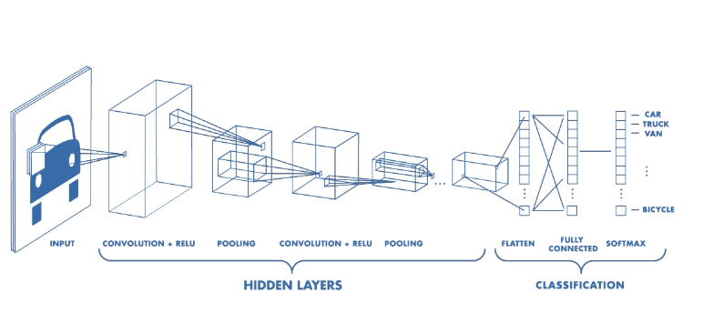
Model Description

Slide 11

Test On real time data-Disgust Prediction

Slide 12

Happiness Prediction

Slide 13
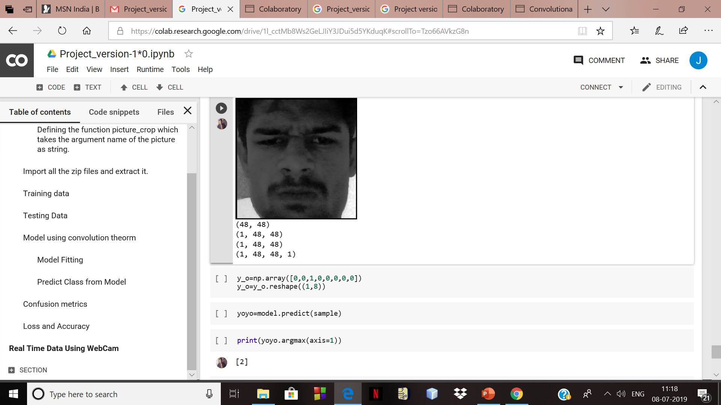
Angry Prediction

Slide 14
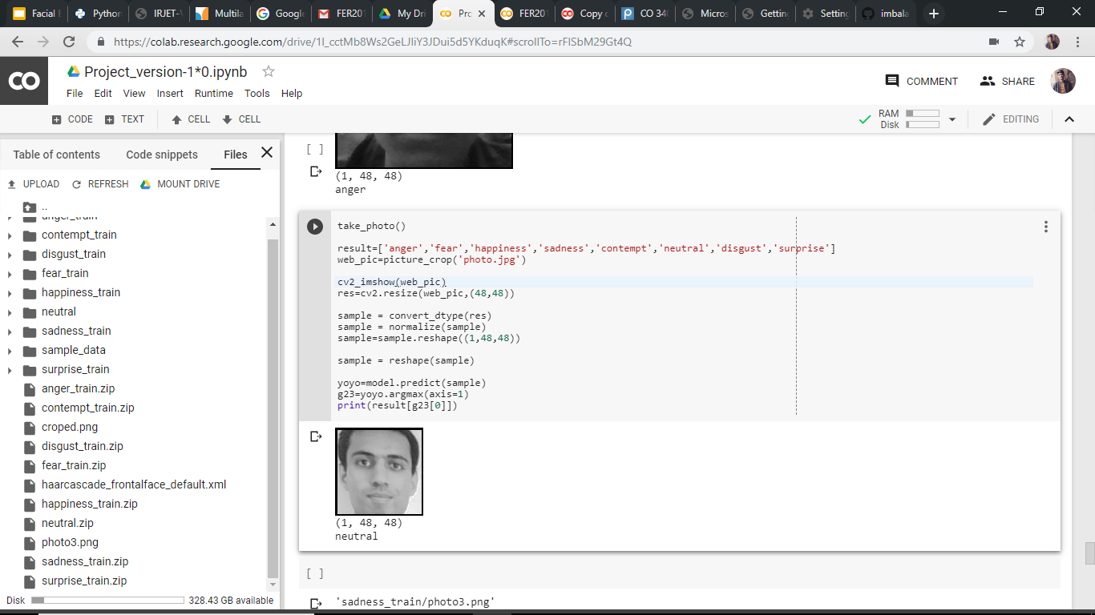
Neutral Prediction

Slide 15

Contempt Prediction

Slide 16

Storing real time data in the dataset for improving model accuracy

Slide 17
Problems Faced
The dataset used was biased with one class i.e., 60% data belonged to single class and the rest of the 40% data belonged to another 7 classes.
Facial feature detection with open-cv had low accuracy.

Slide 18
Future Prospective
Using geometrical features and appearance features and SOM based classification, we can more precisely classify the facial emotions.
Video surveillance

Slide 19
Reference
https://ieeexplore.ieee.org/abstract/document/7747479
https://www.sciencedirect.com/science/article/pii/S0031320313004202

Slide 20
Thank You

